Slide 1
Brief on AMD MIVisionX
Alan Zhang

Slide 2
Overview
MIVisionX toolkit is a set of comprehensive computer vision and machine intelligence libraries, utilities, and applications bundled into a single toolkit. AMD MIVisionX delivers highly optimized open source implementation of the Khronos OpenVX™ and OpenVX™ Extensions along with Convolution Neural Net Model Compiler & Optimizer supporting ONNX, and Khronos NNEF™ exchange formats.
MIVisoinX toolkit components:
AMD OpenVX & OpenVX Extensions
Neural Net Model Compiler & Optimizer
Toolkit
Utilities

Slide 3
AMD OpenVX & OpenVX Extensions
AMD OpenVX Core Lib
vx_loomsl: Radeon LOOM stitching library for live 360 degree video applications
vx_nn: OpenVX neural network module that was built on top of MIOpen (i.e. AMD's cuDNN)
vx_opencv: OpenVX module that implemented a mechanism to access OpenCV functionality as OpenVX kernels
vx_winml: OpenVX module that implemented a mechanism to access Windows Machine Learning(WinML) functionality as OpenVX kernels
Runtime OS: Windows w/ OpenCL SDK, Linux w/ ROCm
Hardware Configuration: CPU: SSE4.1 or above CPU, 64-bit; GPU: Radeon Professional Graphics Cards or Vega Family of Products (16GB required for vx_loomsl and vx_nn libraries)
Notes:
Radeon Loom使用AMDKhronos™OpenVX™开源计算视觉架构，可实时拼接多至24个4k x2k镜头、离线拼接多至31个8K x4K镜头拍摄到的画面。

Slide 4
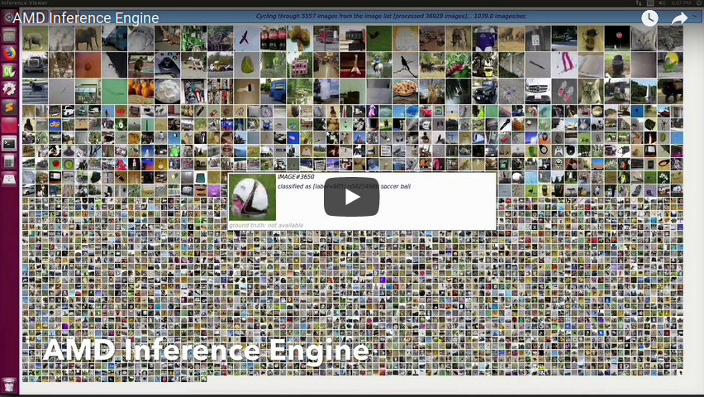
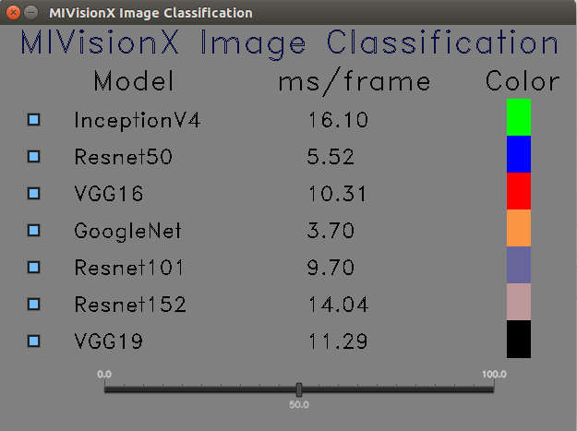
Applications Based on AMD OpenVX
Cloud Inference Application: This sample application does inference using a client-server system.
Digit Test: This sample application is used to recognize hand written digits.
MIVisionX OpenVX Classsification: This sample application shows how to run supported pre-trained caffe models with MIVisionX RunTime.
MIVisionX WinML Classification: This sample application shows how to run supported ONNX models with MIVisionX RunTime on Windows.
MIVisionX WinML YoloV2: This sample application shows how to run tiny yolov2(20 classes) with MIVisionX RunTime on Windows.
External Applications
Notes:
https://gpuopen-professionalcompute-libraries.github.io/MIVisionX/apps/mivisionx_openvx_classifier/
https://github.com/srohit0/trafficVision#traffic-vision

Slide 5
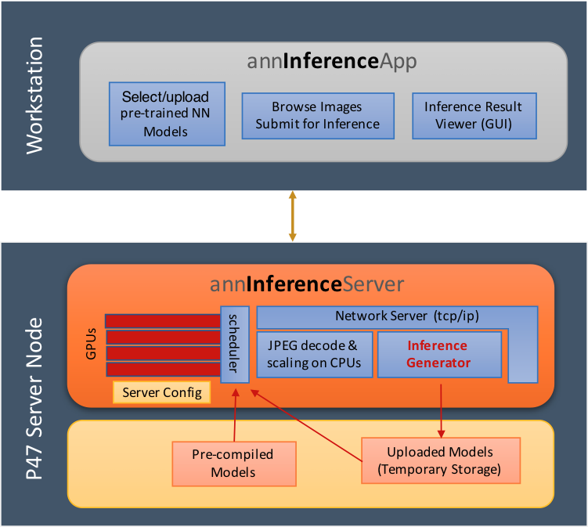
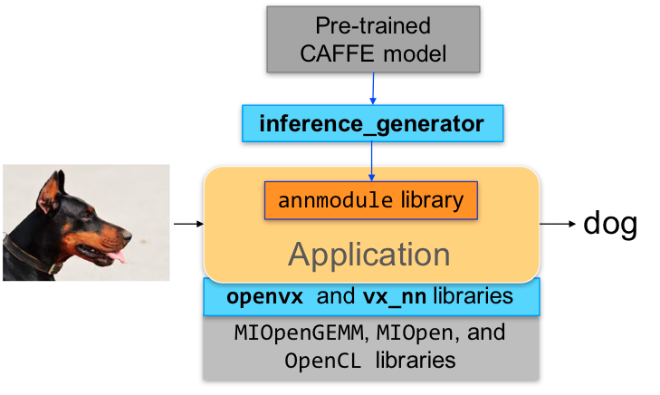
AMD OpenVX Client/Server Demo App

Slide 6
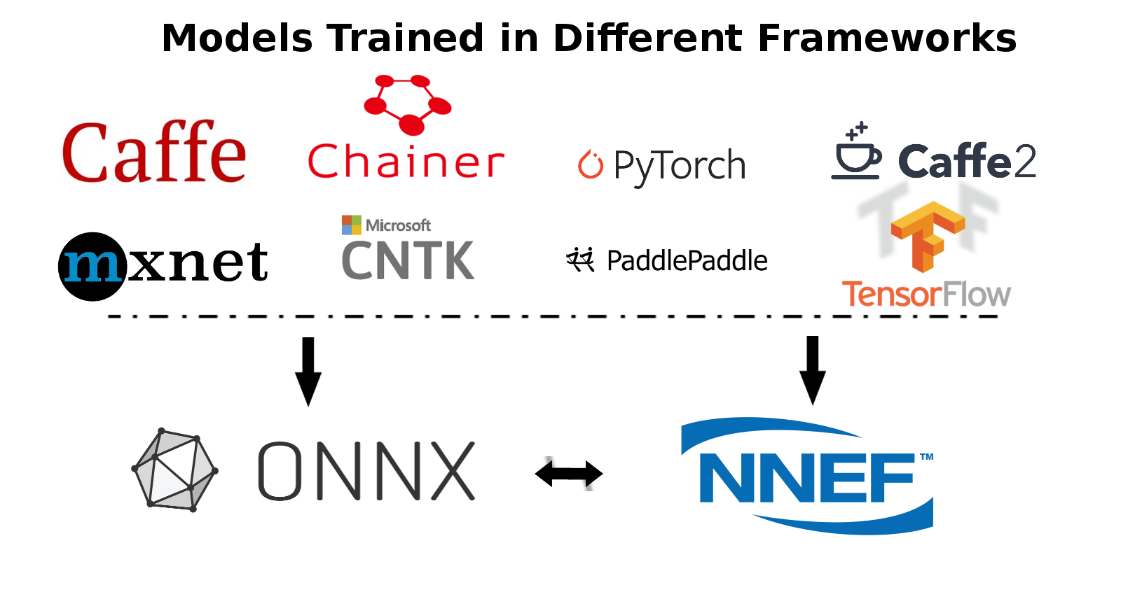
Neural Net Model Compiler & Optimizer
Neural Net Model Compiler & Optimizer converts pre-trained neural network models to MIVisionX runtime code for optimized inference.
MIVisionX RunTime: AMD OpenVX + OpenCV-Interop Kernels
Pre-requisites: Install ROCm, and MIVisionX, numpy, onnx, nnef-parser
Model Compiler & Optimizer Usage
Step 1 - Convert Pre-trained model to AMD NNIR, pre-trained models can be Caffe, ONNX, NNEF;
Step 2 - Apply Optimizations
Update batch size in AMD NNIR model
Fuse operations in AMD NNIR model
Quantize the model to float 16
Workaround groups using slice and concat operations in AMD NNIR model
Step 3 - Convert AMD NNIR to OpenVX C code
Notes:
Models & Operators currently supported:
https://gpuopen-professionalcompute-libraries.github.io/MIVisionX/model_compiler/#mivisionx-runtime

Slide 7
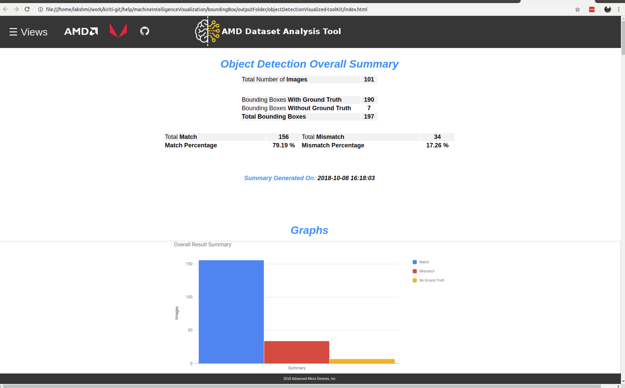
MIVisionX Toolkit
AMD MIVisionX Toolkit, is a comprehensive set of help tools for neural net creation, development, training and deployment.
Output result
Overall Summary
Graphsgraph
Labels
Image Results
Compare
Model Score

Slide 8
Utilities
inference_generator: generate inference library from pre-trained CAFFE models
caffe2openvx: Convert a pre-trained CAFFE model into a C library for use by applications.
loom_shell: an interpreter to prototype 360 degree video stitching applications using a script.It provides direct access to Live Stitch API by encapsulating the calls to enable rapid prototyping.
RunVX: command-line utility to execute OpenVX graph described in GDF text file
RunCL: command-line utility to build, execute, and debug OpenCL programs

Slide 9
Backup

Slide 10
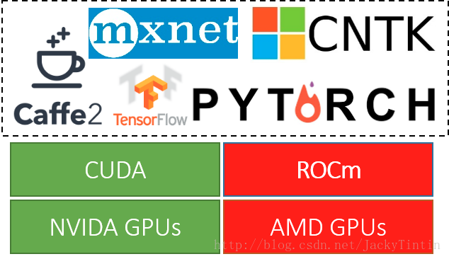
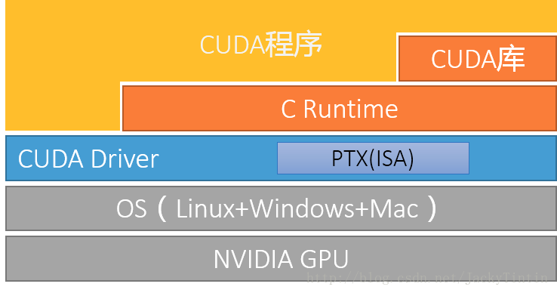
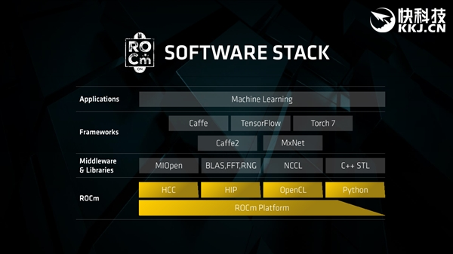
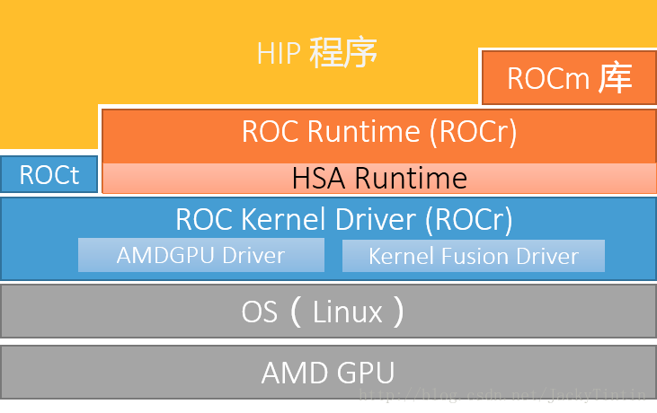
AMD ROCm Overview
ROCm之于AMD GPU，基本上相当于CUDA 之于NVIDIA GPU。
ROCm的目标是建立可替代 CUDA 的生态，并在源码级别上对 CUDA 程序的支持。为了实现目标，ROCm 复制了 CUDA 的技术栈。
Notes:
https://blog.csdn.net/JackyTintin/article/details/74637157
ROCm Software Platform:
https://github.com/ROCmSoftwarePlatform

Slide 11
ROCm vs CUDA
CUDA | ROCm | 备注
CUDA API | HIP | C++ 扩展语法
NVCC | HCC | 编译器
CUDA 函数库 | ROC 库、HC 库
Thrust | Parallel STL | HCC 原生支持
Profiler | ROCm Profiler
CUDA-GDB | ROCm-GDB
nvidia-smi | rocm-smi
DirectGPU RDMA | ROCn RDMA | peer2peer
TensorRT | Tensile | 张量计算库
CUDA-Docker | ROCm-Docker

Slide 12
Deep Learning Framework support for ROCm
Framework | Status | MIOpen Enabled | Upstreamed | Current Repository
Caffe | Public | Yes |  | https://github.com/ROCmSoftwarePlatform/hipCaffe
Tensorflow | Development | Yes | CLA in Progress | Notes: Working on NCCL and XLA enablement, Running
Caffe2 | Upstreaming | Yes | CLA in Progress | https://github.com/ROCmSoftwarePlatform/caffe2
Torch HIP | Upstreaming | Development | In process | https://github.com/ROCmSoftwarePlatform/cutorch_hip
HIPnn | Upstreaming | Development |  | https://github.com/ROCmSoftwarePlatform/cunn_hip
PyTorch | Development | Development
MxNet | Development | Development |  | https://github.com/ROCmSoftwarePlatform/mxnet
CNTK | Development | Development
Notes:
https://github.com/RadeonOpenCompute/ROCm_Documentation/blob/master/Deep_learning/Deep-learning.rst

Slide 13
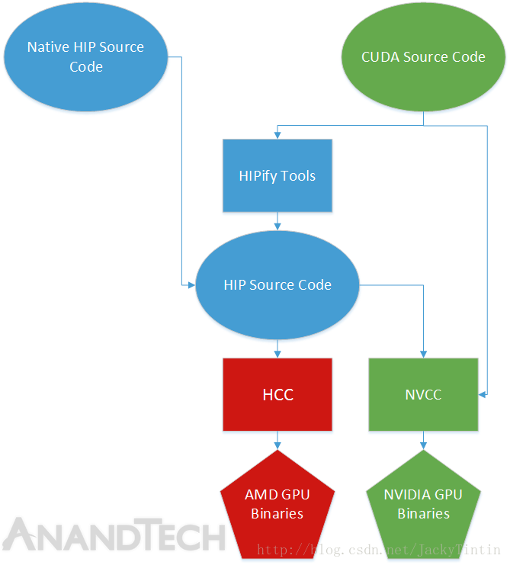
HIP (Heterogeous-compute Interface for Portability，异构计算可移植接口)
HIP 可以说是 CUDA API 的”山寨克隆“版。除了一些不常用的功能（e.g. managed memory）外，几乎全盘拷贝 CUDA API，是 CUDA 的一个子集。
AMD 提供的 HIPify 工具，核心只是一个 perl 脚本，主要功能就是查找与替换。
HCC 是 基于 CLANG/LVVM 的开源编译器，是 ROCm 中 NVCC 的对应工具。相比于 NVCC，HCC 的提供了更多的功能 。HCC 单一编译环境统一支持 ISO C++ 11/14、C14、OpenMP 4.0，并且前向性的支持 C++17 “Parallel STL”，兼容 C++ AMP（微软推出的并行计算 API 标准），而且是同时适用于CPU、GPU。
rocBLAS 接口上兼容 Netlib BLAS 和 cuBLAS-v2 API。
随机数库 hcrng（HC Random Number Generator）
rocFFT 接口设计上与 clFFT 一致。

Slide 14
MIOpen（Machine Intelligence Open）
MIOpen 是 AMD 版的 cuDNN。 最近推出了 MIOpen 基本完成了对 CUDA 的对位复制。支持 OpenCL 和 HIP 两种编程模式。
MIOpen使用了一个叫 MIOpenGEMM 的矩阵乘法库。

Slide 15
THANK YOU

